Slide 1




Bengaluru Transport
Demand Prediction
MILESTONE 3

Slide 2




Introduction
Bengaluru, one of India's fastest-growing cities, faces escalating public transport challenges. Rapid urbanization, rising commuter volumes, and unpredictable peak-hour congestion demand smarter, data-driven transit planning to ensure efficiency and reliability.
Without accurate demand forecasting, transit authorities struggle to allocate resources effectively — leading to overcrowded routes, underutilized buses, and poor service quality. Predictive analytics enables proactive scheduling, optimized routing, and improved passenger experience across the city's bus network.

Slide 3


Problem Statement
Bengaluru's public transport network spans thousands of routes and millions of daily commuters. Without accurate demand forecasting, transit authorities struggle to anticipate passenger volumes across routes and time periods — leading to overcrowded buses, underutilized services, and inefficient scheduling.
The core challenge lies in predicting future passenger demand at the route and stop level, identifying peak-hour surges, and enabling data-driven decisions for capacity planning, fleet allocation, and route optimization across Bengaluru's dynamic urban transport network.

Slide 4
Objectives
Prediction Goals
Planning Goals
Predict future passenger demand across Bengaluru bus routes using historical trip and stop data. Identify peak-hour periods to enable data-driven operational decisions and improve service reliability.
Optimize route planning based on demand forecasts. Enable smarter allocation of buses to high-demand corridors and support long-term public transport network expansion strategies.

Slide 5

Dataset
Route Data
Travel Direction
Passenger Counts
Date & Time
Trip Records
Temporal Attributes
Stop Information
Operational Data

Slide 6



Data Preparation
Raw transport data was cleaned and structured for analysis. Steps included removing duplicate trip records, handling missing passenger counts and stop identifiers, and standardizing time formats (HH:MM:SS) across all route logs. Outliers in passenger load data were filtered using IQR-based thresholds.
Feature engineering involved extracting hour-of-day, day-of-week, and peak/off-peak labels from timestamps. Route direction and stop sequence were encoded as categorical features. The final structured dataset was validated for consistency and split into training and testing subsets for model input.

Slide 7
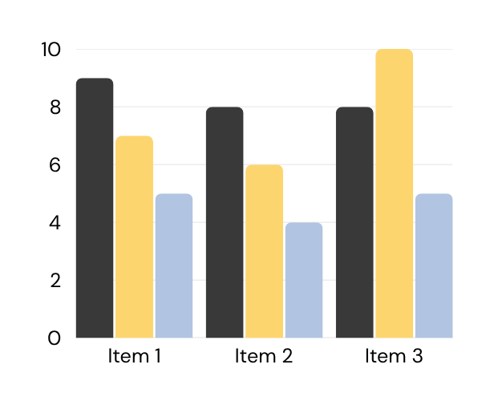
Demand Analysis
Route-wise analysis reveals that Routes 500C, 401G, and 335E record the highest average daily passenger loads, exceeding 1,200 boardings per trip during peak windows. Time-wise demand shows sharp spikes between 8–10 AM and 5–8 PM, with off-peak hours (11 AM–3 PM) showing 40–60% lower ridership. Weekend patterns differ significantly, with leisure routes peaking later in the day. These demand variations form the basis for predictive modelling in the next phase.

Slide 8

Prediction & Forecasting
A time-series forecasting model was applied to predict future passenger demand across Bengaluru bus routes. Peak periods were identified as 8–10 AM and 5–8 PM on weekdays. High-demand corridors showed 35% surge during peak hours. The pie chart illustrates demand share distribution across peak and off-peak windows, enabling smarter resource allocation and route scheduling.

Slide 9
Key Insights
• Routes 5, 12 & 18 consistently show highest passenger demand across all time windows.
• Peak hours identified: 8–10 AM and 5–7 PM on weekdays.
• Weekend demand drops ~35% vs. weekday averages on most routes.
• Inbound city-center routes outperform outbound by 2.1× during morning peak.
• Recurring demand spikes align with school and office zones along key corridors.

Slide 10

Conclusion & Future Scope
Demand prediction enables smarter, data-driven transport planning for Bengaluru.
Future scope: real-time data integration, deep learning models & dynamic route optimization.

